Slide 1
Code Signing Certificate Misissuance in the Wild
Mason Hyman, Julia Steed

Slide 2
Introduction and Motivation

Slide 3
What is the difference between code-signing and TLS certificates?
TLS Certificates:
Encrypts the data exchanged between a user’s web browser and the web server.
Provides confidentiality and integrity.
Verifies the identity of the web server.
Code-Signing Certificates:
Digitally signs software and executable code to improve the security of software distribution.
Provides authenticity and integrity.
Verifies the identity of the software publisher

Slide 4
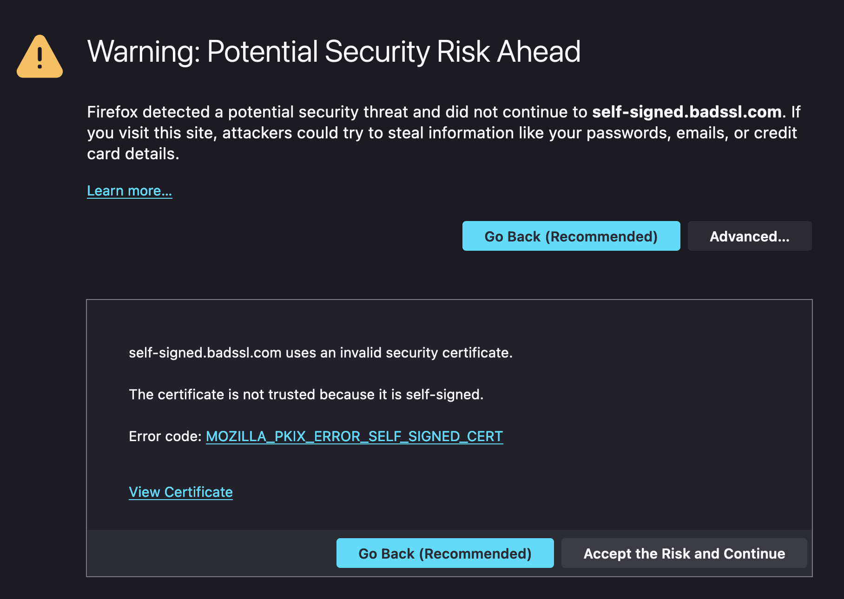
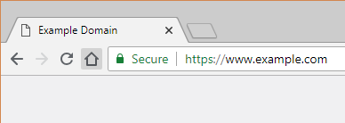
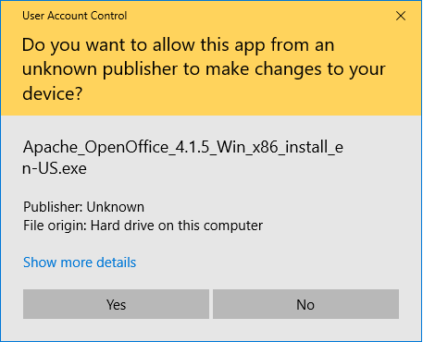
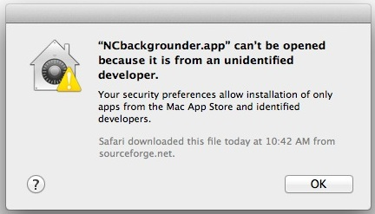
TLS Certificate In Action:
Code Signing Certificate In Action:

Slide 5
Motivation
Our goal with this project is to systematically analyze the errors made by CAs when issuing code-signing certificates.
We define any direct violation of technical standards or community best practices as a misissuance by the issuing certificate authority.
Our work is derived directly from Tracking Certificate Misissuance in the Wild (Kumar et. al.). This paper focused solely on TLS certificates; thus, we wish to extend their work.
5
Paper Source: https://zakird.com/papers/zlint.pdf

Slide 6


What are the standards?
RFC5280 – Internet X.509 Public Key Infrastructure Certificate and Certificate Revocation List (CRL) Profile.
Baseline Requirements for the Issuance and Management of Publicly-Trusted Code Signing Certificates (BRfCSC) – Issued Sep. 21, 2016

Slide 7
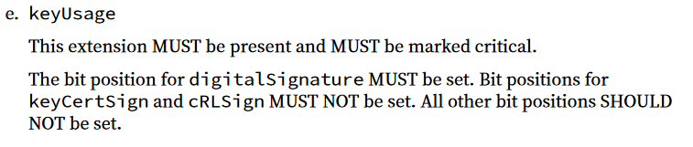
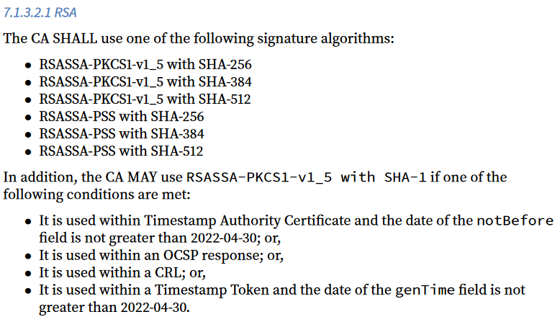
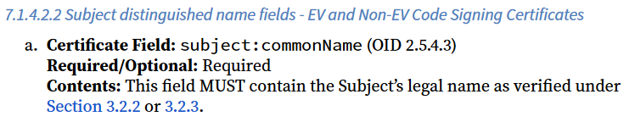
Baseline Requirements (cont.)
The document walks through each section of an X.509 certificate profile and issues requirements for each field:

Slide 8
Methods

Slide 9
Data Collection
To analyze the misissuance of code-signing certificates, we needed a large corpus of signed binaries.
The most commonly available source of signed binaries is from antivirus and security research companies as they have already collected malware samples.
For this project, we collected datasets from popular antivirus vendors and open source repositories of malicious binaries. From these binaries, we extracted the code signing certificates.

Slide 10




Issued after 9/21/16:
Certificates:
Malcert Dataset:
6,322
0
Symantec Dataset:
132,485
10,270
Sorel Dataset:
22,559
7,968
VirusShare Dataset:
20,121
1,561
Total:
19,799

Slide 11
Data Processing
To process a large volume of certificates, we forked ZLint, the X.509 certificate linter used by Kumar et. al.
Because the requirements for TLS certificates and Code-signing certificates are different, we had to make many modifications to the original ZLint program.
Lints Added: 96
Requirement Coverage (Profile-only): ~97%

Slide 12
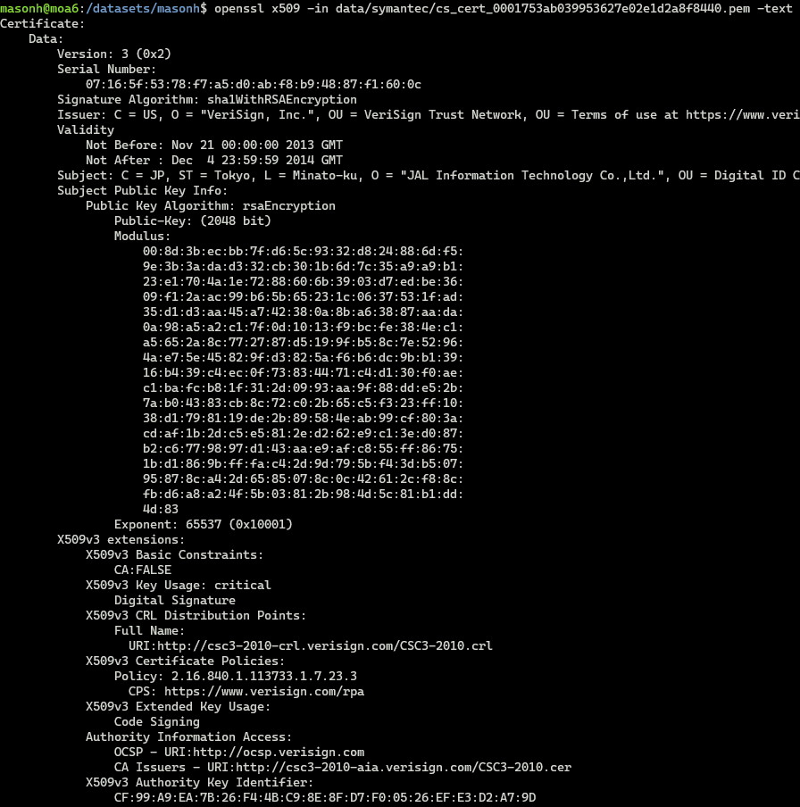
How does ZLint work?
A linter is a static code analysis tool typically used to flag programming errors, bugs, or syntactic errors.
In ZLint’s case, the program checks for misissuances in X.509 certificates by comparing individual fields to their expected or required value.

Slide 13


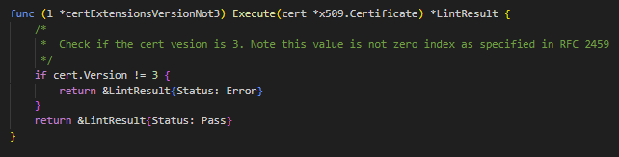
How does ZLint work? (cont.)
In our testing, we measured that ZLint could perform at roughly 250,000 certificates per hour.
ZLint is written in Golang and is configured to write its results to a sqlite3 database.
Example: Execute function for Lint that checks certificate version is 3

Slide 14
Results

Slide 15
Misissuance Quantified
Dataset: | # of Unique Certs Misissued | % of Total | # of Passed | # of Errors | # of Warnings
Symantec | 1,248 | 12.1512% | 341,599 | 548 | 913
Sorel | 706 | 8.8604% | 186,758 | 2,040 | 476
VirusShare | 237 | 16.3997% | 52,370 | 74 | 182
All | 2,192 | 11.0713% | 580,727 | 2,662 | 1,571

Slide 16
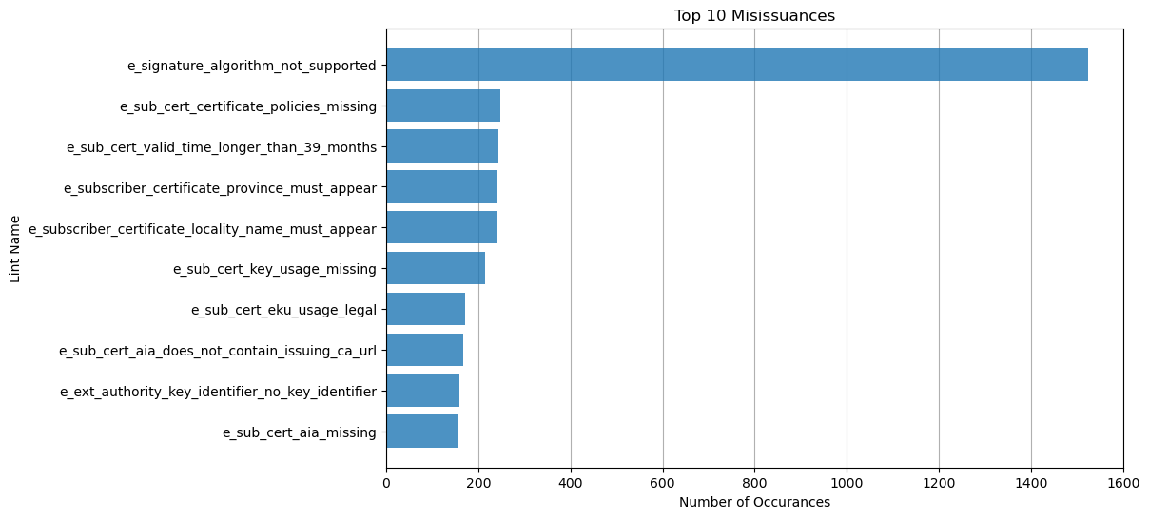
Most Common Misissuances

Slide 17
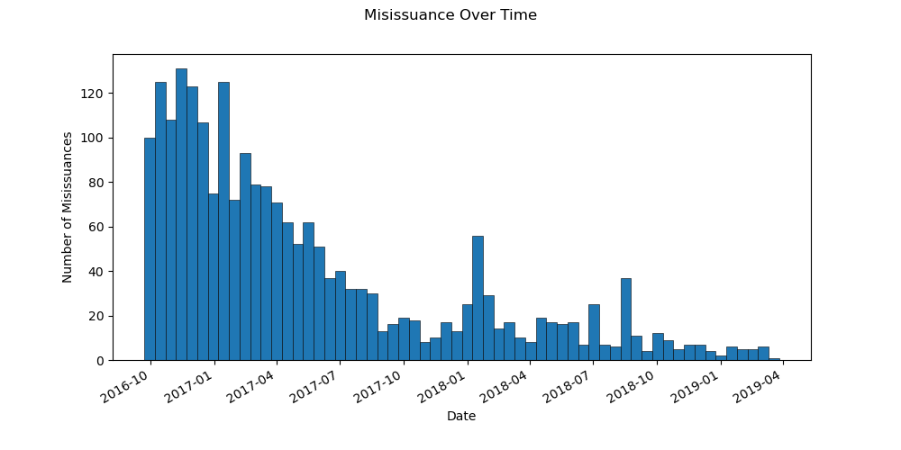
Misissuance Over Time

Slide 18
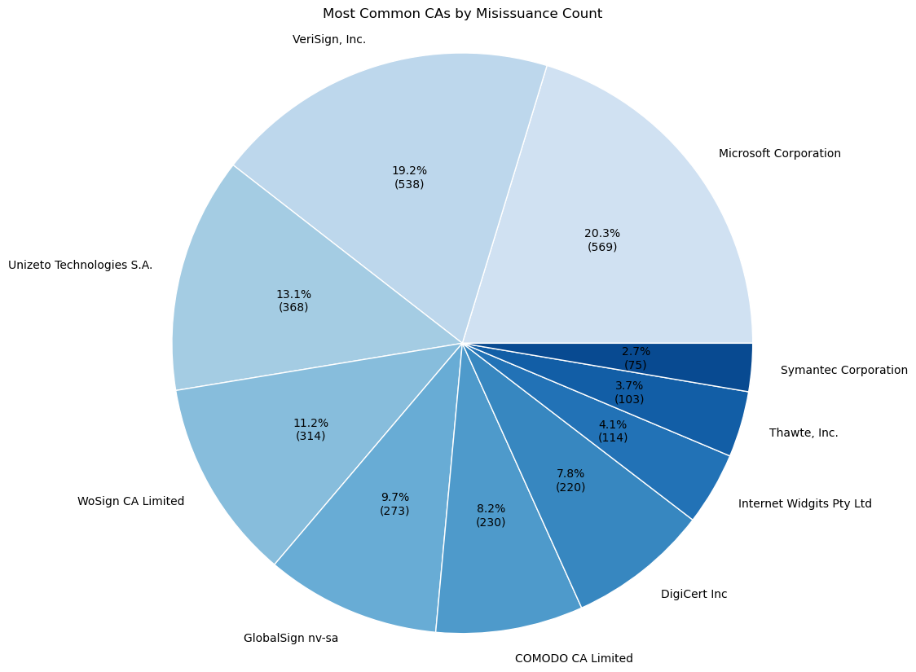
Most Common CAs to Misissue

Slide 19
Discussion

Slide 20
So what do the results tell us?
Based on the identification that 11.1% of code-signing certificates contained a violation of accepted baselines and best practices, there is potential for improvement by certificate authorities.
Compared to the conclusion that only 3.3% of TLS certificates contained violations made by Kumar et. al, one may generalize that certificate authorities make more errors when issuing code-signing certificates.

Slide 21
Most Common Misissuances

Slide 22
What do the most common misissuances tell us?
By a margin of over 1,000 occurrences, signature algorithm misissuances were the most commonly seen among the dataset.
This is mostly due to the transition between RSA-2048 and RSA-3072 and the unclear required transition dates issued by the CA/B Forum.
It should be noted that CAs should be less to blame for these misissuances as the responsibility to set clear transition dates between requirements falls upon the CA/B Forum.

Slide 23
What do the most common misissuances tell us? (cont.)
In the case of key usage and extended key usage misissuances, CAs are clearly to be blamed as the requirements are very straightforward.
In 215 cases (1.11%), the X.509 key usage field was not included despite being required as a critical field.
When not included, certificates become vulnerable to misuse by the holder. If stolen, malicious actors may use the certificate freely to perform unintended actions.

Slide 24
What do the most common misissuances tell us? (cont.)
Within the most common misissuances, there were 476 instances of Authority Information Access (AIA) violations.
This field is required to contain information and links that browsers and other applications can use to check the validity and revocation status of certificates.
Without a proper AIA field, certificate revocation is rendered ineffective. This is a large vulnerability in the current PKI landscape.
24

Slide 25
Next Steps
In order to get a full picture of misissuance as it relates to code-signing certificates, many more certificates are needed.
Ideally, a majority of these certificates would come from benign binaries, which we did not have in this project.
A large corpus of benign, signed binaries would help to rule out some of the noise inherent to datasets of malicious binaries.
It should be noted that collected a large supply of benign binaries is both difficult and computationally expensive (bandwidth, storage).

Slide 26
Next Steps (cont.)
With more certificates, one may begin to examine the differences between the misissuance of Extended-Validation (EV) and Non-EV code-signing certificates.
By examining EV certificates, there may be better indicators as to the health of the code signing ecosystem.
Additionally, a deep dive into the effectiveness of the current baseline requirements should be performed as well as examining their usability by CAs.

Slide 27
Code Signing Certificate Misissuance in the Wild
Mason Hyman, Julia Steed

